Slide 1

Climate Change Green Paper Update & What Individuals Can Do
Chantal Lass, Climate Change Manager
Alex Byott, Climate Change Project Officer
Emma Ratheram, Climate Change Assistant

Slide 2
New Climate Change Strategy
Commissioned joint research with the Local Plan team.
Project 1: Climate Change Mitigation and Adaptation Study.
Project 2: Clean Energy Opportunities and Implications Study.
Project 3: Accelerating the Road to Net Zero.
Baselining and emissions projections.
Pathway to net zero.
a high-level climate risk and vulnerability assessment (flooding, heat, extreme weather).
Suggested climate adaptation and accelerated route to Net Zero.

Slide 3
Organisation and residents survey Spring 2024 – a few highlights
34 local organisations and 448 residents.
Provided a snapshot of local perspectives.
30% residents believe climate change affecting the district now and 63% believe it will in the future.
80% of organisations concerned about the impacts of climate change on their operations.
84% or organisations see addressing climate change as an opportunity too.
40% residents are unaware of local climate initiatives despite being concerned and wanting to act.
90% of organisations were concerned about energy costs and seeking ways to improve energy efficiency.

Slide 4
Climate Green Paper
New Draft Vision:
Wealden district is climate resilient, biodiversity rich, environmentally sustainable. Our communities, natural environment and economy can withstand and thrive amidst the challenges posed by climate change.
Two new draft targets:
Wealden district will achieve net zero by 2044 and …
the District Council commits to reaching net zero in our own operations by 2040.

Slide 5
Underpinned by 7 key Principles
Ensuring a Just Transition, Ensuring the Journey to Net Zero is Fair for Everyone.
Partnership and Collaboration.
Focus on the Needs of the District.
Working with Residents and Local Communities.
Harnessing Innovation and Technological Advancements.
Ensuring Climate Action Delivers Other Benefits Where Possible.
Making Financial Decisions Based on the Evidence.

Slide 6
Co-benefits of Climate Action
Health
Citizen and Community Engagement
Equity and Inclusion
Community/Social Cohesion
Local Economy and Jobs
Long Term Financial Resilience
Education
Nature and Biodiversity
Resilience and Adaptation
Energy Security
Resource Use

Slide 7
Draft Mission and Strategic Themes
Mission: “To lead the way in tackling climate change by supporting a sustainable, resilient, and environmentally aware community.”
8 draft strategic themes:
Communication and Engagement
Buildings and Energy
Energy Generation
4. Travel and Transport.
5. Resource Consumption and Waste.
6. Land Use, Biodiversity and Water.
7. A Green Low Carbon Economy.
8. Governance and Leadership

Slide 8
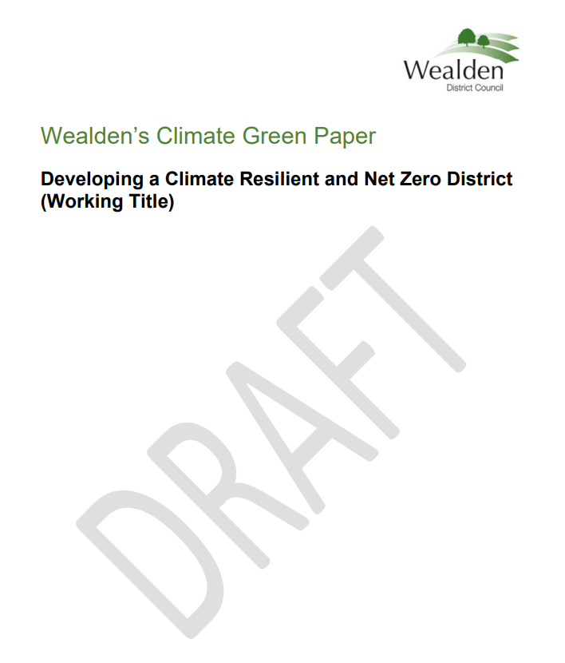
Climate Green Paper Update
Due to be adopted in July 2025 by Cabinet and Full Council.
New Action Plan with a focus until April 2028 with possibility of legacy projects beyond Wealden District Council (TBC).

Slide 9
What Individuals Can Do
Why individual action matters
Climate change affects us all – locally and globally.
Governments and businesses have key roles, but individuals are part of the solution.
Every small action contributes to bigger change.
A quick look …
Energy at home
Travel choices
What we eat
Shopping and consumption
Nature and wildlife
impact-tool.org.uk
Developed by Centre for Sustainable Energy and University of Exeter.

Slide 10
Emission reductions

Slide 11
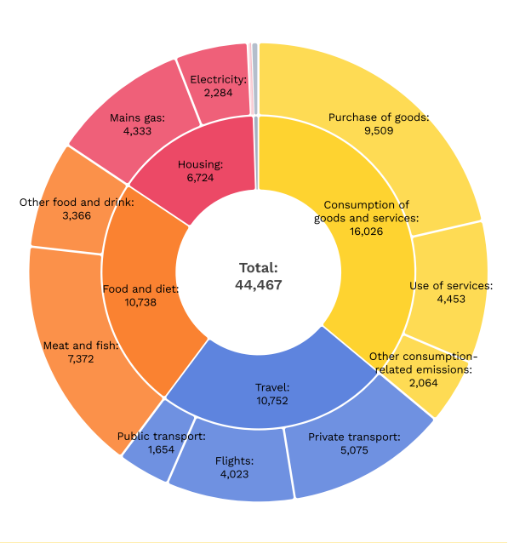
What about Polegate?
15%
Each household in Polegate generates around 10 tonnes of carbon dioxide equivalent (tCO₂e) annually through consumption.
impact-tool.org.uk
36%
24%
24%

Slide 12
Energy at home
Switch to renewable electricity tariffs.
Improve insulation and draught-proofing to cut heating use.
Use LED lighting and switch off appliances.
Lower your thermostat by 1-2°C – can cut bills and emissions.
For Polegate …
Housing = 15%
Most energy in our homeS is used for space heating, heating hot water, lighting and appliances and cooking.

Slide 13
Travel choices
Walk, cycle or use public transport where possible e.g. Flexi Bus
Consider car sharing.
Reduce flying over time – take the train and holiday closer to home ‘stay cation’
Great resources compare travel options eg RouteZero.world and rometorio.com
For Polegate …
Travel = 24%
Car ownership varies across the 3 wards
No car average – 11%
1 car average 40%
2 car average 25% (up to 39%)
3 or more average 12%

Slide 14
What we eat
Buy local, seasonal food to reduce transport emissions.
Cut food waste – plan meals, store food well, and compost where possible.
Eat more whole food plant-based meals.
For Polegate …
Food and diet = 24%
Changing what we eat has a greater impact on carbon emissions than changing where our food has travelled from – e.g. going vegetarian one day a week!

Slide 15
Shopping and consumption
Buy less, choose quality over quantity.
Donate, support second-hand shopping.
Repair rather than replace – join or start a Repair Café.
For Polegate …
Consumption of goods and services = 36%
Waste = 1%

Slide 16


Nature and wildlife
Gateway to South Downs National Park.
and the Cuckoo Trail.
Polegate Jubilee Nature Reserve
Blue Heart an innovative project helping to predict and mitigate the impacts of local flooding.

Slide 17
Together, we make a difference
Change starts here – the choices we make as individuals, together, shape the future of a community.
Every action counts – whether it’s planting a tree, cutting energy use, or supporting local food.
Lead by example – when people see neighbours taking action, they’re more likely to join in.

Slide 18
Links
Home energy grants:
https://www.wealden.gov.uk/environment-and-pollution/home-energy-efficiency/home-energy-grants-loans-and-discounts/
Let’s Talk Wealden:
https://letstalk.wealden.gov.uk/hub-page/climate-change
Carbon footprint calculators:
https://impact-tool.org.uk/
https://footprint.wwf.org.uk/

